Slide 1
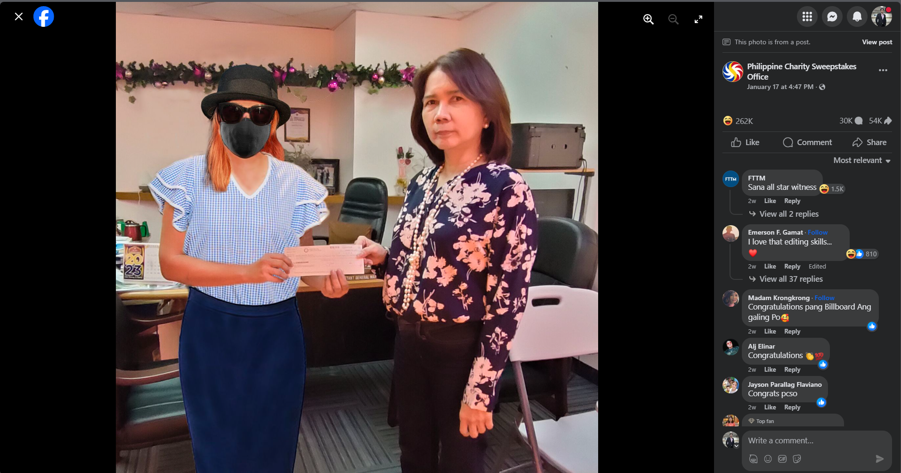

Slide 2
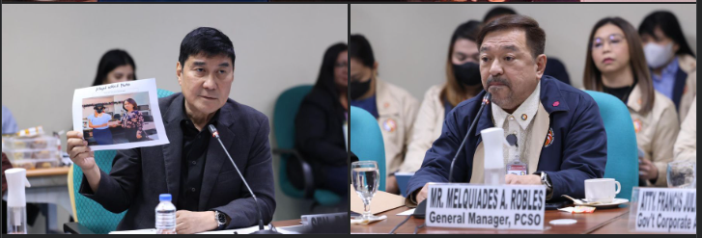

Slide 3
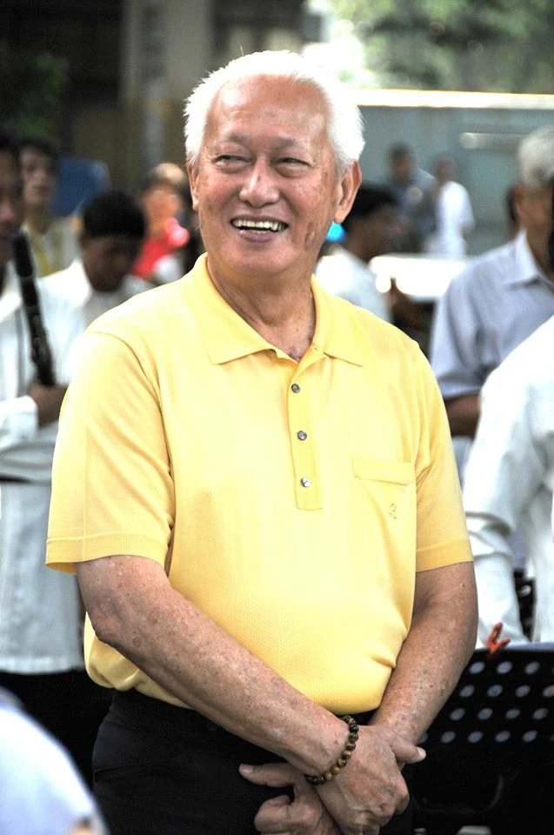

Slide 4
Sweepstake is free no need to pay to win
Lotto need to buy ticket to get a chance to win

